Slide 1
Search Statements and Binding
Search statements are the statements of an information that need to be generated by users to specify the concepts they are trying to locate in items.
The search statement uses traditional Boolean logic and/or Natural Language.
In generation of the search statement, the user may have the ability to weight (assign an importance) to different concepts in the statement.
Binding in this sense is when a more abstract form is redefined into a more specific form.

Slide 2
The search statement is the user’s attempt to specify the conditions needed to subset logically the total item space to that cluster of items that contains the information needed by the user.
The next level of binding comes when the search statement is parsed for use by a specific search system.
The search system translates the query to its own metalanguage. This process is similar to the indexing of item.

Slide 3
For example,
Statistical systems determine the processing tokens of interest and the weights assigned to each processing token based upon frequency of occurrence from the search statement.
Natural language systems determine the syntactical and discourse semantics using algorithms similar to those used in indexing.
Concept systems map the search statement to the set of concepts used to index items.

Slide 4
The final level of binding comes as the search is applied to a specific database. This binding is based upon the statistics of the processing tokens in the database and the semantics used in the database.
This is especially true in statistical and concept indexing systems. Some of the statistics used in weighting are based upon the current contents of the database.
Some examples for Statistical Weighting in Search are Document Frequency and Total Frequency for a specific term.
Document Frequency (DF): How many documents in the database contain a specific term.
Total Frequency (TF): How often a specific term appears across all documents in the database.
These statistics are dynamic and depend on the current contents of the database being searched.

Slide 5
Frequently in a concept indexing system, the concepts that are used as the basis for indexing are determined by applying a statistical algorithm against a representative sample of the database versus being generic across all databases.
Natural Language indexing techniques tend to use the most corpora-independent algorithms, meaning they rely less on the specific contents of a single database and aim for more general language patterns.
Parenthesis are used in the second binding step to indicate expansion by a thesaurus.
The length of search statements directly affect the ability of Information Retrieval Systems to find relevant items. The longer the search query, the easier it is for the system to find items.

Slide 6
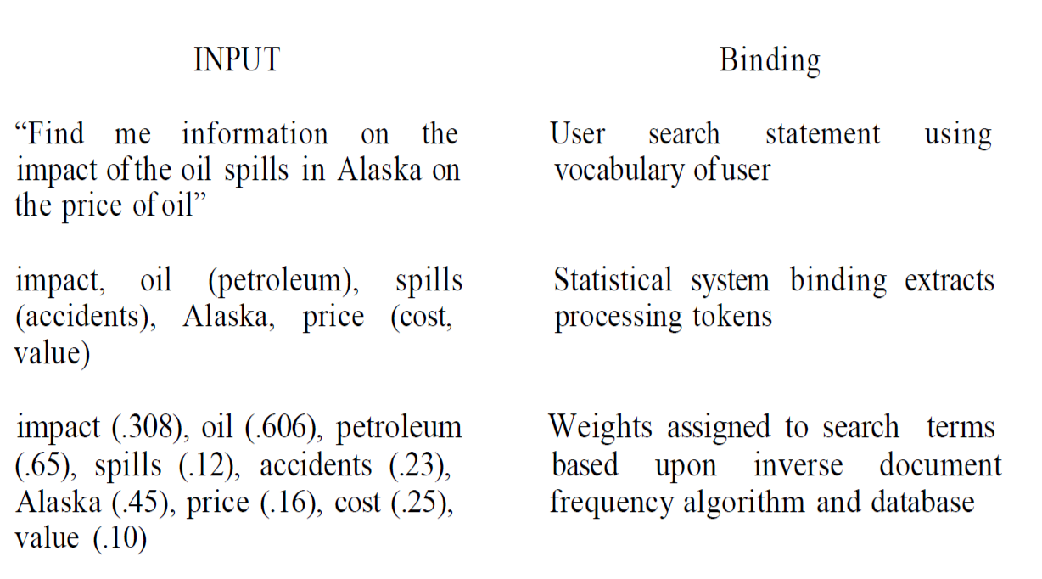
Examples of query binding

Slide 7

Similarity Measures and Ranking
A variety of different similarity measures can be used to calculate the similarity between the item and the search statement. A characteristic of a similarity formula is that the results of the formula increase as the items become more similar. The value is zero if the items are totally dissimilar.
This formula uses the summation of the product of the various terms of two items when treating the index as a vector. If is replaced with then the same formula generates the similarity between every Item and The problem with this simple measure is in the normalization needed to account for variances in the length of items. Additional normalization is also used to have the final results come between zero and +1

Slide 8
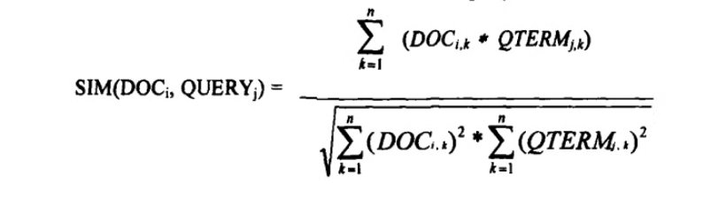
Similarity Measures: Cosine Similarity
Vector-Based
Cosine similarity measures the cosine of the angle between two non-zero vectors in a multi-dimensional space.
Outputs a value between -1 and 1, with 1 indicating identical vectors.
Efficient Computation
Can be calculated efficiently using dot products, making it a popular choice for IR systems.

Slide 9
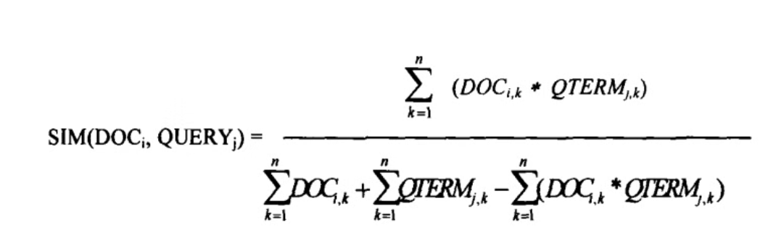
Similarity Measures: Jaccard Similarity
Set-Based
Range of Values
Applications
The Jaccard similarity coefficient measures the similarity between two finite sets.
As the common elements increase, the similarity value quickly decreases, but is always in the range -1 to +1.
Useful for comparing the overlap between documents, tags, or other categorical data.

Slide 10
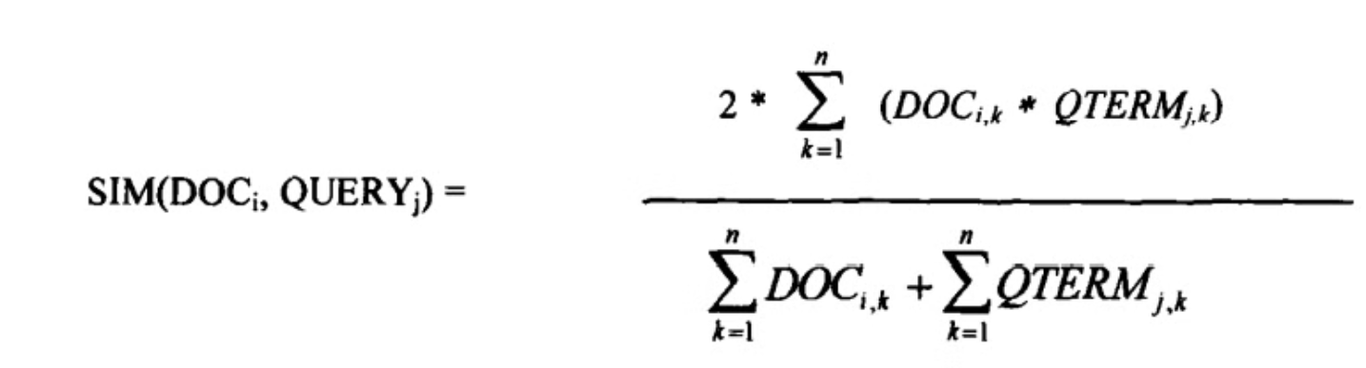
Similarity Measures: Dice Method
The Dice measure simplifies the denominator from the Jaccard measure and introduces a factor of 2 in the numerator. The normalization in the Dice formula is also invariant to the number of terms in common.
For the Dice value, the numerator factor of 2 is divided into the denominator. As long as the vector values are same, independent of their order, the Cosine and Dice normalization factors do not change.

Slide 11
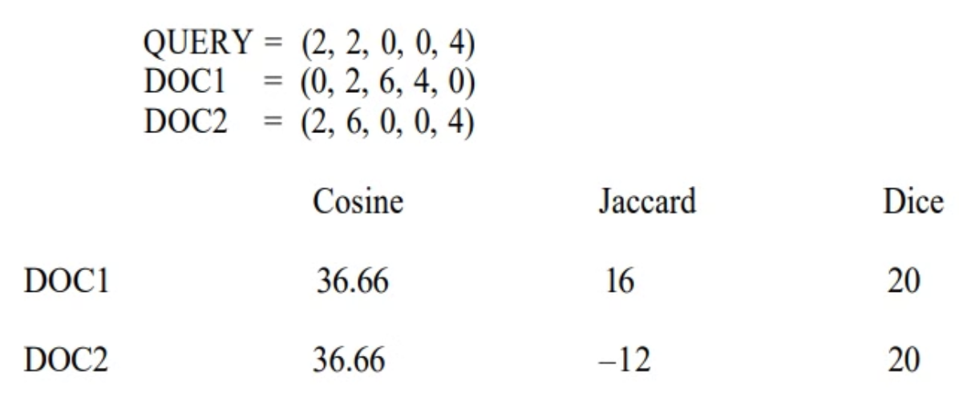
Threshold in Similarity Measures
Use of a similarity algorithm returns the complete data base as search results. Many of the items have a similarity close or equal to zero (or minimum value the similarity measure produces). For this reason, thresholds are usually associated with the search process. The threshold defines the items in the resultant Hit file from the query. Thresholds are either a value that the similarity measure must equal or exceed or a number that limits the number of items in the Hit file.

Slide 12
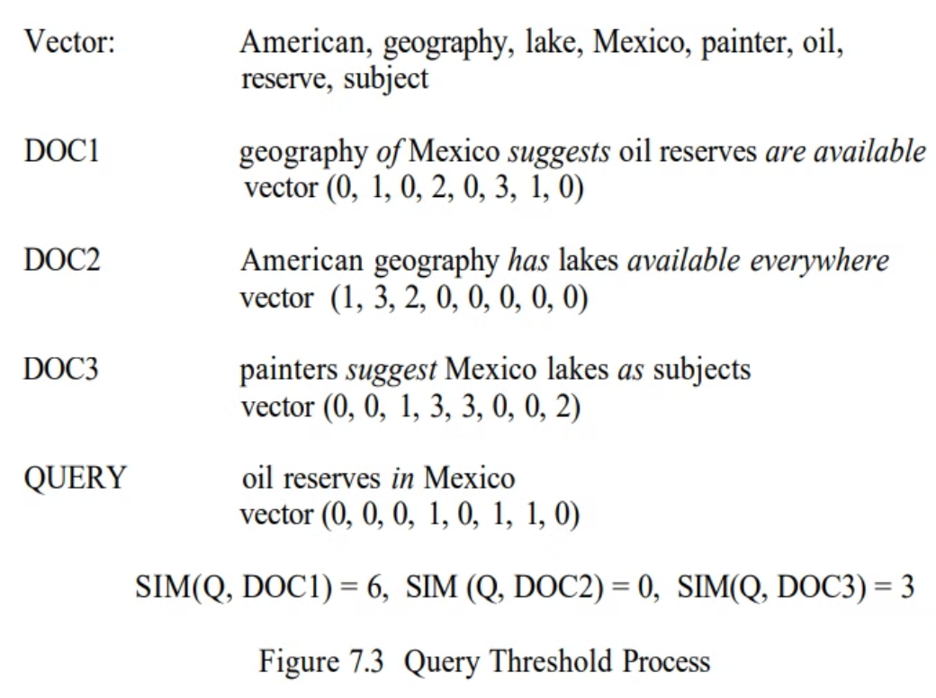

Slide 13
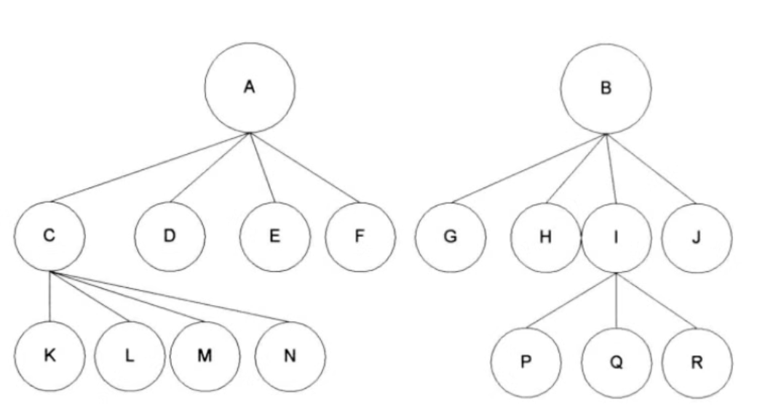
Clustering Hierarchy
The items are stored in clusters that are represented by the centroid for each cluster.
The hierarchy is used in search by performing a top-down process. The query is compared to the centroids “A” and “B.” If the results of the similarity measure are above the threshold, the query is then applied to the nodes’ children. If not, then that part of the tree is pruned and not searched. This continues until the actual leaf nodes that are not pruned are compared.
The risk is that the average may not be similar enough to the query for continued search, but specific items used to calculate the centroid may be close enough to satisfy the search.

Slide 14

Hidden Markov Models Techniques
In HMMs the documents are considered unknown statistical processes that can generate output that is equivalent to the set of queries that would consider the document relevant.
Another way to look at it is by taking the general definition that a HMM is defined by output that is produced by passing some unknown key via state transitions through a noisy channel. The observed output is the query, and the unknown keys are the relevant documents
The development for a HMM approach begins with applying Bayes rule to the conditional probability:
By applying Bayes rule to the conditional probability, we can derive an expression for the posterior probability, which represents the probability of a document being relevant given the query and the observed output. This posterior probability is then used to make decisions on document relevance in HMMs. The goal is to find the most likely sequence of hidden states (relevant documents) that generate the observed output (query).

Slide 15
A Hidden Markov Model is defined by a set of states, a transition matrix defining the probability of moving between states, a set of output symbols and the probability of the output symbols given a particular state. The set of all possible queries is the output symbol set and the Document file defines the states.
Thus the HMM process traces itself through the states of a document (e.g., the words in the document) and at each state transition has an output of query terms associated with the new state.
The biggest problem in using this approach is to estimate the transition probability matrix and the output (queries that could cause hits) for every document in the corpus. If there was a large training database of queries and the relevant documents they were associated with that included adequate coverage, then the problem could be solved using Estimation-Maximization algorithms.

Slide 16
Ranking Algorithms
A by-product of use of similarity measures for selecting Hit items is a value that can be used in ranking the output. Ranking the output implies ordering the output from most likely items that satisfy the query to least likely items. This reduces the user overhead by allowing the user to display the most likely relevant items first.
The original Boolean systems returned items ordered by date of entry into the system versus by likelihood of relevance to the user’s search statement. With the inclusion of statistical similarity techniques into commercial systems and the large number of hits that originate from searching diverse corpora, such as the Internet, ranking has become a common feature of modern systems.
In most of the commercial systems, heuristic rules are used to assist in the ranking of items. Generally, systems do not want to use factors that require knowledge across the corpus (e.g., inverse document frequency) as a basis for their similarity or ranking functions because it is too difficult to maintain current values as the database changes and the added complexity has not been shown to significantly improve the overall weighting process.

Slide 17
RetrievalWare System
RetrievalWare first uses indexes (inversion lists) to identify potential relevant items. It then applies coarse grain and fine grain ranking. The coarse grain ranking is based on the presence of query terms within items. In the fine grain ranking, the exact rank of the item is calculated. The coarse grain ranking is a weighted formula that can be adjusted based on completeness, contextual evidence or variety, and semantic distance.
Completeness is the proportion of the number of query terms (or related terms if a query term is expanded using the RetrievalWare semantic network/thesaurus) found in the item versus the number in the query. It sets an upper limit on the rank value for the item. If weights are assigned to query terms, the weights are factored into the value. Contextual evidence occurs when related words from the semantic network are also in the item.
Thus if the user has indicated that the query term “charge” has the context of “paying for an object” then finding words such as “buy,” “purchase,” “debt” suggests that the term “charge” in the item has the meaning the user desires and that more weight should be placed in ranking the item. Semantic distance evaluates how close the additional words are to the query term.
Synonyms add additional weight; antonyms decrease weight. The coarse grain process provides an initial rank to the item based upon existence of words within the item. Since physical proximity is not considered in coarse grain ranking, the ranking value can be easily calculated.

Slide 18
Fine grain ranking considers the physical location of query terms and related words using factors of proximity in addition to the other three factors in coarse grain evaluation. If the related terms and query terms occur in close proximity (same sentence or paragraph) the item is judged more relevant. A factor is calculated that maximizes at adjacency and decreases as the physical separation increases.
Although ranking creates a ranking score, most systems try to use other ways of indicating the rank value to the user as Hit lists are displayed. The scores have a tendency to be misleading and confusing to the user. The differences between the values may be very close or very large.

Slide 19

JNTUH UNIVERSITY COLLEGE OF ENGINEERING
SCIENCE AND TECHNOLOGY HYDERBAD
DEPARTMENT OF COMPUTER SCIENCE AND ENGINEERING.
Information Retrieval Systems :
Relevance Feedback - Unit 4
Faculty:
Team members:
Ms. Bharani Priya V
A.Manideep (21011P0503)
Assistant Professor(C)
Galib Amin (21011P0532)

Slide 20
Relevance Feedback
Relevance feedback is a feature of information retrieval systems that improves the effectiveness of search queries.
It is a mechanism that allows users to provide feedback on the relevance of returned results to their
search query.
This feedback is then used to refine and improve future search results.
Relevance feedback can be explicit or implicit, depending on how the information is collected from
the user.

Slide 21


Initial Query
Initial Results
Doc -1
Doc-2
Query
Results
IRS
Doc-3
Doc-4
User
Doc-5
Relevance Feedback
Query Modified
Doc -1
Doc-2
Doc-7
Doc-10
Revised Results

Slide 22


Slide 23
Relevance feedback processes
Initial Query
Initial Results
Feedback Phase
Query Refinement
Revised Results

Slide 24
Relevance feedback processes generally involve the following steps:
Initial Query: The user submits a search query to the system.
Initial Results: The system returns a set of initial search results based on the query.
Feedback Phase: The user provides feedback on the relevance of the returned results. This can be done explicitly (e.g., by marking documents as relevant or irrelevant) or implicitly (e.g., through analysis of user interaction with the results).
Query Refinement: The information retrieval system refines the search query based on the feedback. This may involve
altering the query terms, adjusting term weights, or using other methods to better capture the user's information need.
Revised Results: The system returns a new set of search results based on the refined query, ideally more closely aligned with the user's needs.

Slide 25
Relevance Feedback
Implicit Relevance Feedback:
This type of feedback gathers information on user behavior and preferences without requiring direct input. For example, the system may monitor which search results the user clicks on, how much time they spend reading a document, or whether they save or share it. These actions are interpreted as signals of relevance, and the system adjusts future search results accordingly.
Explicit Relevance Feedback:
This involves the user actively indicating whether a returned result is relevant or not. For example, after performing a search, a user may mark certain documents as "relevant" or "irrelevant" to their query. The information retrieval system uses this feedback to adjust the search algorithm, often by modifying the query terms or weights associated with those terms, to return results that are more closely aligned with the user's needs in subsequent searches.
Positive Feedback
Negative Feedback

Slide 26
Relevance Feedback
Implicit Relevance Feedback
Explicit Relevance Feedback:

Slide 27
Implicit Relevance Feedback
User Behavior:
Implicit feedback is gathered by observing user actions and behaviors during their interaction with the system.
Types of Actions:
Actions that can be considered as implicit feedback include clicks, time spent on a document, scrolling, mouse movements, bookmarking, and downloading.
No Explicit Input:
Users do not directly indicate their preferences; the system deduces them from the observed behavior.
Relevance Signals:
Certain actions, like spending a long time on a page or repeatedly returning to a specific document, are strong signals of interest.

Slide 28
Explicit Relevance Feedback
Users directly communicate their preferences regarding the relevance of search results
Positive Feedback
Negative Feedback

Slide 29
Positive Feedback
Positive feedback occurs when users indicate that a particular set of results or documents are relevant to their search query
This might involve the user marking certain search results as "relevant" or indicating their preference for certaintypes of documents.
This can involve increasing the weight of certain search terms, adding new terms that are related to the relevant documents,

Slide 30
Negative Feedback
Users indicate that certain results or documents are not relevant to their search query
This can be done explicitly by marking documents as "irrelevant"
This might involve decreasing the weight of certain terms associated with irrelevant documents

Slide 31
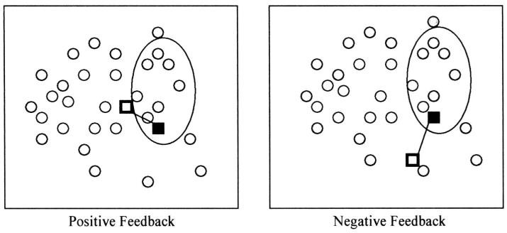
The oval represents the items that are returned from the query.
The solid box is logically where the query is initially.
The hollow box is the query modified by relevance feedback.

Slide 32
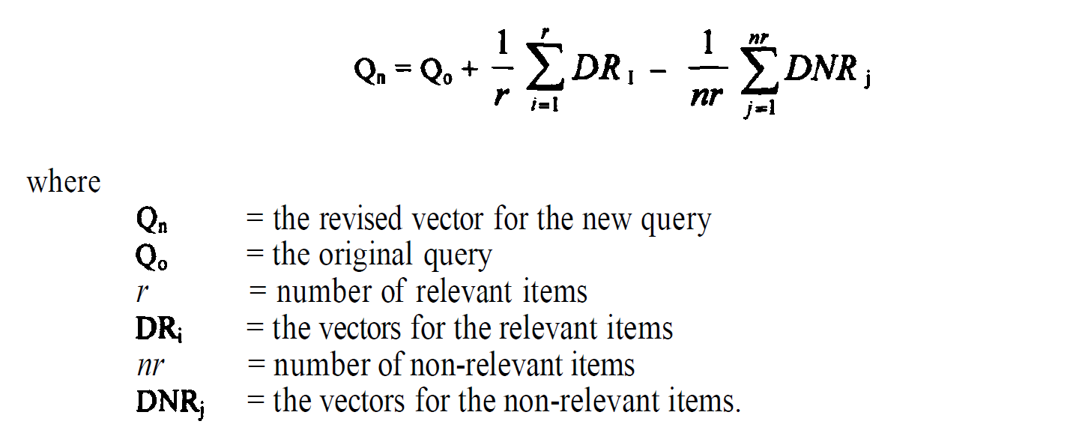
Rocchio Method for Relevance feedback

Slide 33
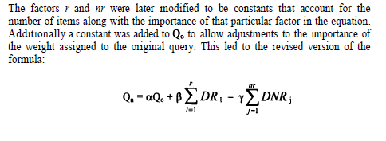
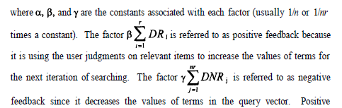

Slide 34
Experiments show that relevance feedback helps improve search results significantly.
Queries with relevance feedback work better than those manually adjusted by users.
It’s especially useful when users enter short queries with only a few words.
Pseudo-relevance feedback automatically assumes the top search results are relevant.
This process is also called blind feedback or local context analysis.
The system expands the original query using feedback from top results to improve accuracy.
A new set of search results is shown based on the expanded query.
Overall, using automatic feedback leads to better search performance compared to not using it.

Slide 35
THANK YOU

Slide 36
Selective Dissemination of Information
In
Information Retrieval System

Slide 37
Selective Dissemination of Information
Selective Dissemination of Information (SDI) is a process used in information retrieval systems to automatically
filter and send relevant information to users based on their pre-defined interests, profiles, or search criteria.
The key features of SDI include:
User Profiles: The system collects information on the specific interests, preferences, and needs of each user. This profile is then used to identify the most relevant information for that user.
Automated Searching: Based on the user profiles, the system continuously monitors various sources of information (such as
databases, journals, websites) for new content that matches the users' interests.
Notification: When the system identifies relevant new information, it automatically notifies the user, often via email, dashboard updates, or personalized feeds.
Feedback Loop: Many SDI systems include a mechanism for users to provide feedback on the relevance of the information received. This feedback is used to refine and improve the accuracy of future information dissemination.

Slide 38




(New document)
(User)
Analysis, Indexing (Processing)
User’s Interest and
their browsing history
(Document Database)
(User Profile file)
Matching
SDI Output
User Response

Slide 39



Pull: Users actively search or query the system to retrieve information (Pulling Information). The IRS provides relevant information based on the search query entered by the user.
Pull (Searching Information): Users initiate queries to the IRS to retrieve specific information.
Push: Information is automatically disseminated to users based on pre-defined interests or profiles (Pushing Information). This is known as Selective
Push (Selective Dissemination): The IRS monitors content and pushes relevant information to users based on predefined interests.
User
IRS
(User) (IRS)
Pulling Information (Query)
Pushing Information (SDI)

Slide 40




Example:
Friend -1
Friend -3
Friend -2

Slide 41
(SDI System)

Slide 42

Introduction to Information Visualization in Information Retrieval Systems
Information visualization plays a crucial role in modern information retrieval systems, enhancing data exploration and decision-making.

Slide 43
History of Information Visualization
Early Pioneers
Modern Era
Innovations in data representation in the 18th and 19th centuries.
Explosion of data and visualization techniques for complex information.
1
2
3
Computational Advancements
Rise of computers and software enable interactive visualizations.

Slide 44

Key Features
Information visualization has several key features that make it an essential component of information retrieval systems. Firstly, it allows users to perceive and understand large amounts of data quickly and efficiently. Additionally, it enables users to identify patterns, trends, and outliers within the data, which aids in decision-making and analysis. Moreover, information visualization offers interactivity, allowing users to manipulate the data and explore multiple perspectives, fostering a more engaging and immersive experience.

Slide 45
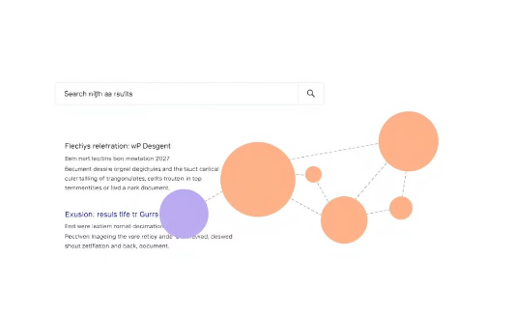
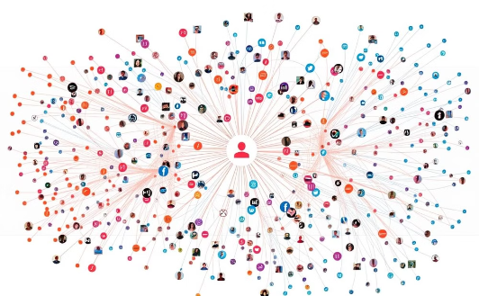
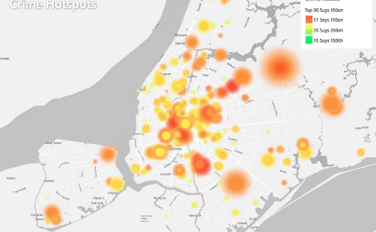
Applications of Information Visualization
Search Result Visualization
Social Media Analytics
Geospatial Analysis
Enhancing browsing and understanding of search outcomes.
Analyzing user behaviors and information diffusion patterns.
Uncovering spatial patterns and relationships in data.

Slide 46

Challenges in Effective Information Visualization
Data Complexity
User Interaction
Representing high-dimensional, heterogeneous data in intuitive ways.
Designing intuitive, efficient, and accessible interfaces.
Cognitive Limitations
Ethical Considerations
Accounting for human perception and information processing abilities.
Ensuring visualizations are unbiased and promote informed decisions.

Slide 47





Emerging Trends and Future Directions
Big Data Visualization
AI-Powered Visualizations
Handling massive, dynamic data sets with scalable techniques.
Leveraging machine learning for automated insights and recommendations.
Immersive Experiences
Collaborative Visualization
Integrating virtual and augmented reality for data exploration.
Facilitating shared understanding and decision-making among teams.

Slide 48
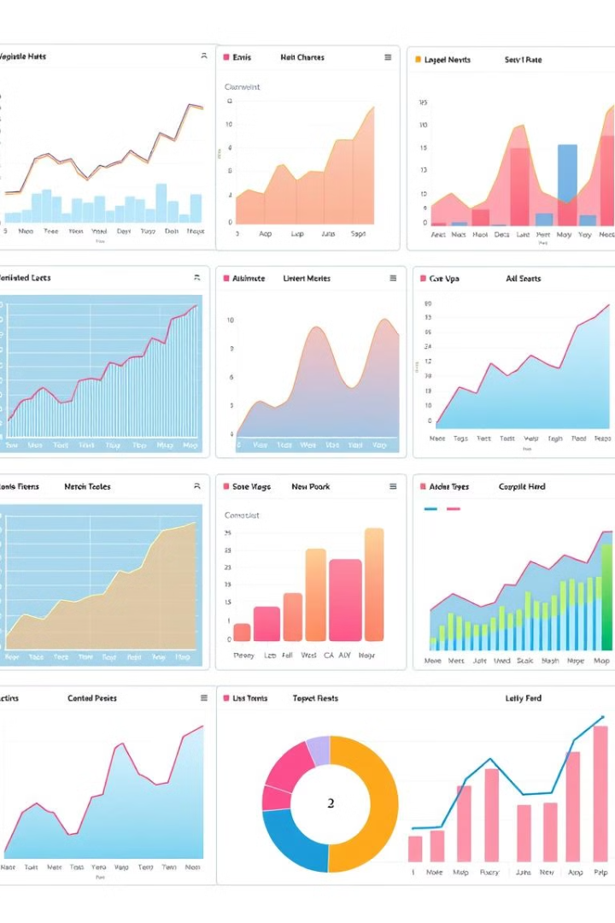



Conclusion
Transformative Potential
Information visualization revolutionizes information retrieval and analysis.
Continuous Evolution
Advancements in technology drive new visualization paradigms.
Interdisciplinary Collaboration
Leveraging expertise from various fields to unlock insights.

Slide 49
THANK YOU

Slide 50
INFORMATION VISUALIZATION TECHNOLOGIES
Done by:
21011P0509
21011P0518

Slide 51
Information Visualization Technologies
Definition:
Information Visualization involves presenting complex data in graphical formats to enhance understanding and decision-making.
The theories associated with information visualization are being applied in commercial and experimental systems to determine the best way to improve the user interface, facilitating the localization of information. They have been applied to many different situations and environments
Importance:
Helps in discovering insights, patterns, and correlations in data.
Critical in environments such as weather forecasting, architectural design, and more.
The ones focused on Information Retrieval Systems are investigating how best to display the results of searches, structured data from DBMSs and the results of link analysis correlating data.

Slide 52
Goals of IRS linked to Information Visualization Techniques
Key Areas of Focus of information visualization techniques:
Displaying search results and structured data from databases.
Correlating data through link analysis.
The goals for displaying the result from searches fall into two major classes:
Document Clustering:The goal of document clustering is to present the user with a visual representation of the document space constrained by the search criteria.
Ex:Visualization tools in this area attempt to display the clusters, with an indication of their size and topic, as a basis for users to navigate to items of interest. This is equivalent to searching the index at a library and then pursuing all the books on the different shelf locations that are retrieved by the search. The second goal is to assist the user in understanding why items were retrieved, thereby providing information needed to refine the query.
Search Statement Analysis:Modern search algorithms and ranking techniques make it difficult to understand query impacts. Search Statement Analysis helps the users understand why specific items were retrieved and how to refine queries.

Slide 53
Structured Databases and Link Analysis
Structured Databases:
Organizes citation and semantic data that describe documents.
Link Analysis:
Correlates documents by analyzing relationships between events and timelines.
For example, a time/event link analysis correlates multiple documents discussing a oil spill caused by a tanker. Even if all of the items retrieved on the topic are relevant, displaying the documents correlated by time may show dependencies of events that are of information importance and are not described in any specific document.

Slide 54
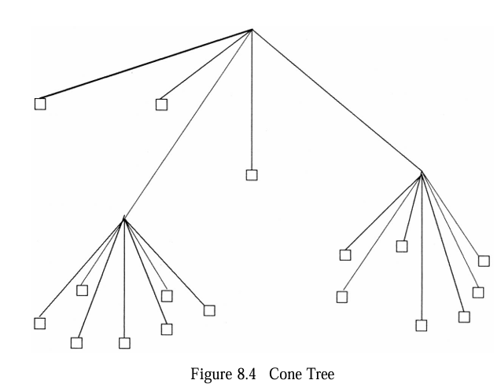
Different Ways Of Organizing the Information
Hierarchical Information Organization
Tree structures are used to represent information over time or across larger units.
A two-dimensional representation becomes difficult for a user to understand as the
hierarchy becomes large.
So we use Cone-tree and Tree
Maps techniques.
Cone-Tree: 3D representation
of hierarchical data.The squares
at the leaf nodes in tree are the
actual documents. Higher level
nodes can be considered centroids
representing the semantic of the
child nodes.

Slide 55
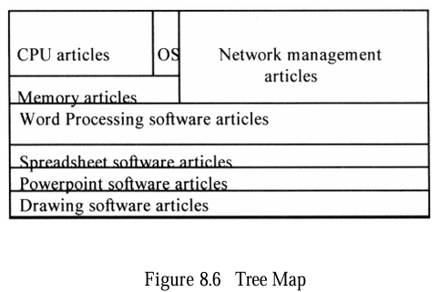
Tree Maps
Use screen space to display parent-child data structures efficiently. This technique maximizes screen space and shows topic relationships by using rectangular boxes. Each box represents parent-child relationships within the data. The size of the boxes indicates the number of items in a topic, and their location shows topic relationships.
Ex: A particular information work space focused on articles on computers may appear as
shown below:
The CPU, OS, Memory, and
Network management articles
are all related to a general
category of computer operating
systems versus computer
applications which are shown
in the rest of the figure.

Slide 56
Semantic Scatterplots
When the information has network-type relationships, an approach using clusters can be shown via a semantic scatterplot.
A graphical technique to display relationships between data points.
Vineta and Bead Systems use 3D scatterplots for data clustering.
Semantic Landscape: Use elevation to indicate the frequency and importance of concepts.
The difficulty of representing all of the axis is overcome by projecting the space onto a plane and using elevation to indicate the frequency of occurrence and importance of a theme (concept) creating a semantic landscape.The detailed relationships between items and their composite themes can be seen by the valleys, cliffs and ranges shown on the terrain map.

Slide 57
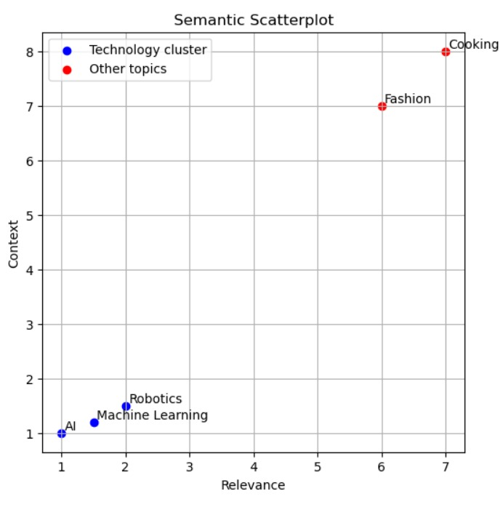
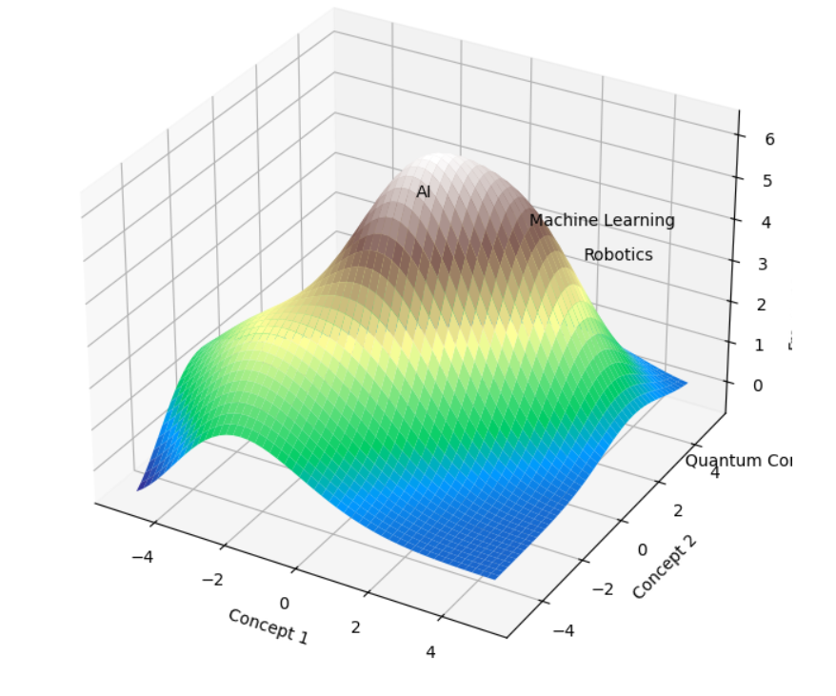
.

Slide 58
Visualization for Search Refinement
Challenges:
Modern search algorithms and ranking systems complicate the understanding of query results.
The goal of many visualization techniques is to show the semantic relationships between individual items to assist the user in locating those groups of items of interest. Another objective of visualization is in assisting the users in refining their search statements. It is difficult for users in systems using similarity measures to determine what are the primary causes for the selection and ranking of items in a Hit file.
Visualization tools need to assist the user in understanding the effects of his search statement even to the level of identifying important terms that are not contributing to the Envision Interface search process. One solution is a graphical display of the characteristics of the retrieved items which contributed to their selection.
Envision System: Displays index terms, relevance rank, and estimated relevance of search results interactively. The Envision system not only displays the relevance rank and estimated relevance of each item found by a query, but also simultaneously presents other query information.

Slide 59
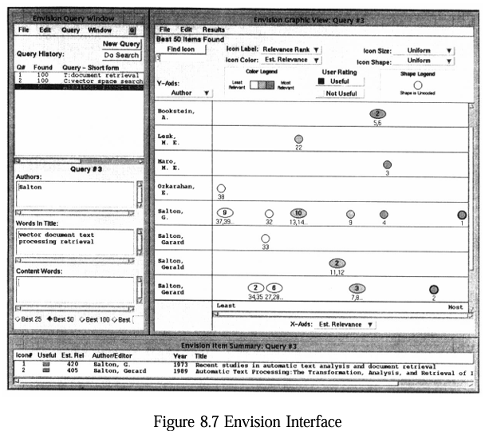
Ex: Circles represent single
items with the relevance
weights displayed below them.
Ellipses represent clusters of
multiple items that are located
at the same point in the
scatterplot with the
number of items in the ellipse
and their weights below
the ellipse. In this example,
estimated relevance is on the
X-axis and author’s name is on
the Y-axis. This type of interface
provides a very user friendly
environment but encounters
problems when the number of
relevant items and entries for an
axis becomes very large. Envision
plans to address this issue by a
“zoom” feature that will allow
seeing larger areas of the
scatterplot at lesser detail.
Veerasamy and Belkin’s System: They use a series of vertical columns of bars. The columns of bars represent documents, and the rows represent index terms. The height of the bar corresponds to the weight of the corresponding term (row) in the corresponding item (column). In addition to the query terms, the system shows the additional words added to the system by relevance feedback.

Slide 60
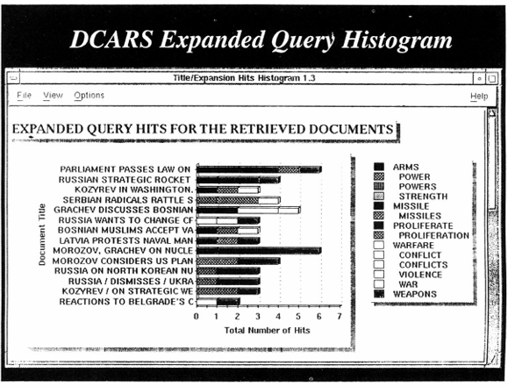
Document Content Analysis and Retrieval System Representations
DCARS:
Displays query results
as histograms showing
term contributions.
Enhances understanding
of how search statements
influence retrieval.
They display the query
results as a histogram with
the items as rows and each
term’s contribution to the
selection indicated by the width of a tile bar on the row
DCARS provides a friendly user interface that indicates why a particular item was found, but it is much harder to use the information in determining how to modify search statements to improve them.

Slide 61
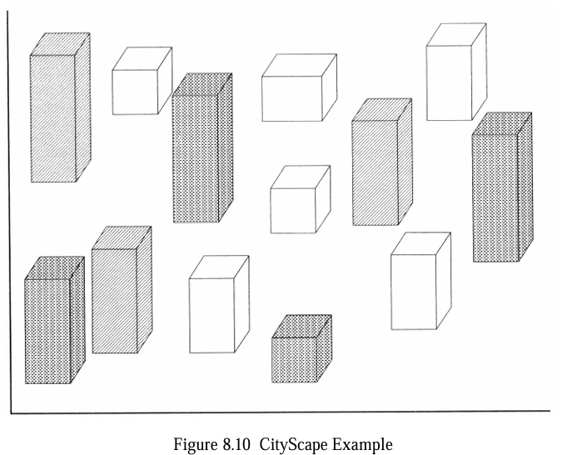
Cityscape
A metaphor that uses buildings
to represent themes or concepts
in 3D space.
This is similar to extending bar
charts to three dimensions. Buildings
can be connected by lines which can
vary in representation to describe
interrelationships between themes.
An easily understood metaphor for users is that of a library. The cityscape functions like a library, with rooms representing different information areas or themes. As users navigate through the 3D space, they can enter different “information rooms” (or themes/buildings).Once inside, they interact with the content (or data) in a meaningful way:Bookshelves could visually store virtual books that contain relevant data for that theme.Each book can represent a sub-topic or specific dataset within the broader theme.Opening a virtual book allows users to explore a set of related items, each represented as a page, making data exploration interactive and organized.

Slide 62
VISUALIZING SPECIFIC TEXT
Another task in information systems is the visualization of specific text within an item versus between items. In some situations, items are allowed to change over time via editing. Thus, there is both the static representation and a time varying representation. Text changing representations are very important when the text being represented is a software program of millions of lines of code.
Ex: AT&T Bell laboratories created the SeeSoft system which uses columns and color codes to show when different lines of code have been changed. This technique was used as a basis for a similar code visualization tool, DEC FUSE/SoftVis. Here a user can quickly see the relative structure of all of the code files composing a system along with the complexity of each of the modules.

Slide 63
Visualizing Structured Databases
Although information retrieval focuses on the unstructured text, another aspect of informational items is the citation data and structured aspects of indexing items. This data structure can be manipulated via structured databases as well as traditional information systems.
Query By Example (QBE) and Information Visualization and Exploration Environment (IVEE) use visual representations of structured databases for efficient search and exploration.
Query By Example (QBE): Developed by IBM, QBE is the first visual query tool that allows users to create queries by providing examples, making it easier to retrieve data from structured databases.
How it Works:
Users create a query by filling out a template or form with example data they want to find. The system then translates this example into a database query.
Example: Imagine you have a database of books with the following fields: Title, Author, and Publication Year.
Scenario: You want to find books written by "J.K. Rowling".
INPUT:
Title: [blank]
Author: "J.K. Rowling"
Publication Year: [blank]
The system retrieves all books authored by J.K. Rowling, showing you relevant entries without needing to write a SQL query like SELECT * FROM books WHERE Author = 'J.K. Rowling'.

Slide 64
Visualizing Structured Databases
Information Visualization and Exploration Environment (IVEE)
What is IVEE?
The Information Visualization and Exploration Environment (IVEE) is a tool that uses visual representations, like 3D graphics and starfield displays, to help users explore structured databases. It allows users to see data in an interactive way based on their search criteria.
How it Works:
Users input search criteria, and IVEE generates a visual representation of the data, making it easier to identify patterns, relationships, and relevant information.
Example: Consider a structured database of houses for sale with attributes like Price, Location, and Number of Bedrooms.
Scenario: You want to find houses in "New York" under $500,000 with at least 3 bedrooms.
IVEE Input: You set your criteria in the IVEE interface.
Result: IVEE displays the houses in a 3D environment, where each house is represented as a point in space. You can rotate and zoom in/out to explore various options visually. The houses that meet your criteria are highlighted, making it easy to compare them at a glance.

Slide 65
Specialized Visualization Tools
Another area in information visualization is the representation of pattern and linkage analysis. A system that incorporates many information visualization techniques including those used to represent linkage analysis is the Pathfinder. It contains the Document Browser, Counts, CrossField Matrix, OILSTOCK and SPIRE tools.
Document Correlation:
SPIRE Tool: Uses scattergraphs to cluster items based on term concurrence.
Pathfinder Project: Combines several visualization techniques for linkage analysis.
OILSTOCKPlaces data on geographic maps, illustrating how information relates to specific locations.Text Representation:
SeeSoft System: Visualizes changes in code over time.

Slide 66
Conclusion
Information visualization is essential for simplifying complex data.
Tools like Cone-Trees, Tree Maps, and scatterplots are vital for clustering and understanding search results.
Specialized systems like DCARS, SPIRE, and Envision provide enhanced user interaction with data.
Future Directions:
Continuous innovation in visualization technologies is needed to deal with increasing data complexity and volume.

